Slide 1

Vel Tech Rangarajan Dr. Sagunthala R&D Institute of Science and Technology
School of Computing
Department of Computer Science and Engineering
10211CS224 / FULL STACK APPLICATION DEVELOPMENT (JAVA)
PROJECT REVIEW : MILESTONE PROJECT – 1
Date: 24-03-2026
Responsive E-Commerce Interface With State – Persistent Cart
SDG: 8,9 – Decent Work and Economic Growth, Industry, Innovation and Infrastructure
Presented By:
K.TANUJA – VTU25866 – 23UECS0256
Courses Handling Faculty:
Dr. HAFIZUR RAHMAN. – ASSISTANT PROFESSOR

Slide 2
INTRODUCTION
In today's digital era, e-commerce has become an essential part of daily life, transforming how people shop and businesses operate.
However, many small businesses and local entrepreneurs struggle to establish an online presence due to the high cost and complexity of existing e-commerce platforms.
Traditional shopping requires physical store visits, which limits customer reach and convenience, especially during situations like pandemics or for people with mobility issues.
Existing solutions often require technical expertise to set up, expensive subscriptions, or come with features that small businesses don't need, making them inaccessible to beginners.
This project is important because it democratizes e-commerce by providing a free, simple, and user-friendly platform that anyone can use to start selling online.
The real-world relevance is evident as more consumers prefer online shopping, and businesses need affordable digital solutions to stay competitive in the modern market.
ModernMart is a responsive e-commerce web application that provides essential features including user authentication, product catalog, state-persistent shopping cart, and wishlist management.
Built with HTML5, CSS3, JavaScript, PHP, and MySQL, this system offers a complete online shopping experience that small businesses can deploy easily without technical expertise.
1
2
3
4
5
6
7
8
9

Slide 3
PROBLEM STATEMENT
1
Small businesses today cannot afford expensive e-commerce platforms that require technical expertise and monthly fees. They are forced to rely on physical stores with limited reach, while customers increasingly prefer online shopping. Existing solutions either cost too much or lack essential features like persistent shopping carts and wishlists. When customers browse basic websites, their cart items disappear after they navigate away. There's no way to save favorite products for later, leading to lost sales. Most affordable options don't work well on mobile phones or lack proper user authentication. Small business owners need a simple solution they can set up themselves without technical knowledge. ModernMart solves all these problems by providing a free, user-friendly e-commerce platform with all essential features built-in.
2
3
4
5
6
7
8
9

Slide 4
OBJECTIVE(S)
1
2
To design and develop a responsive frontend interface using HTML5, CSS3, and JavaScript with real-time validation for improved user experience.
To implement a secure backend system using PHP and MySQL for user authentication, session management, persistent cart storage, and wishlist database operations.
3
4
5
6
7
8
9

Slide 5
PROPOSED SYSTEM
Complete E-Commerce Solution - ModernMart is a free, all-in-one online store platform with product catalog, user accounts, shopping cart, and wishlist - everything a small business needs to start selling online.
Secure User Authentication - Registration and login system with password hashing and session management. Dual-layer validation (JavaScript + PHP) ensures security and data integrity.
Dynamic Product Display - Products are fetched from MySQL database and displayed in a responsive grid with images, prices, categories, and real-time stock updates.
State-Persistent Shopping Cart - Cart items are saved using PHP sessions - they don't disappear on page refresh or navigation. Users can adjust quantities and see instant subtotal calculations.
Personal Wishlist - Logged-in users can save favorite products to their wishlist (stored in database) and add them to cart with one click.
Fully Responsive Design - Works perfectly on desktop, tablet, and mobile. Features hamburger menu, touch-friendly buttons, and adaptive layouts.
How It Solves Problems of Existing systems –
• Eliminating cost barriers – 100% free platform with no subscriptions or hidden fees • Removing technical barriers – Zero coding needed, simple upload-and-use setup • Bridging feature gaps – Professional persistent cart and wishlist like Amazon • Solving accessibility issues – Fully responsive design working on all devices
Key Advantages - Zero cost , Easy setup , Complete features , Secure , Responsive , Customizable
1
2
3
4
5
6
7
8
9

Slide 6
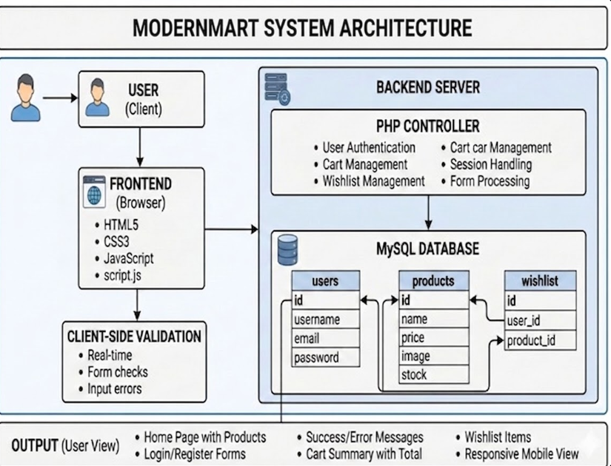
PROPOSED SYSTEM ARCHITECTURE
1
2
3
4
5
Component | Definition
INPUT | User actions like clicks, form submissions, and page requests that trigger the system
PROCESSING | PHP logic that validates, calculates, and decides what action to take based on input
DATABASE | MySQL storage that permanently saves and retrieves user data, products, and wishlist items
OUTPUT | Dynamic HTML pages, success/error messages, and updated content displayed to user
6
7
8
9

Slide 7
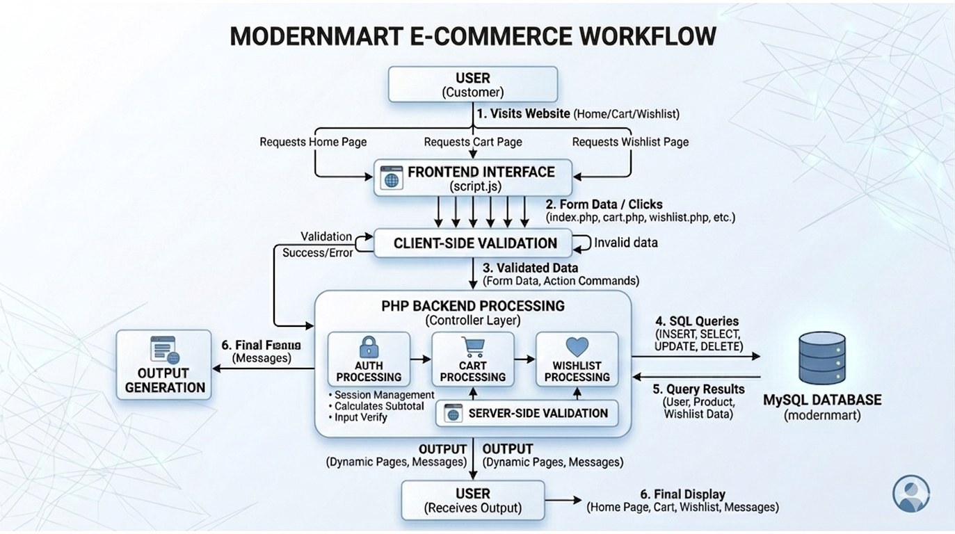
WORKFLOW
1
2
3
4
5
6
7
8
9

Slide 8
TECHNOLOGIES USED
FRONTEND – HTML5 , CSS , JavaScript
BACKEND - PHP
DATABASE – MySQL (phpMyAdmin)
TOOLS – XAMPP , Visual Studio Code , Google Chrome
HARDWARE REQUIREMENTS - Intel Core i3 Processor, 4GB RAM
SOFTWARE REQUIREMENTS - Windows/Linux/macOS , Apache Server , PHP 7.4+ , MySQL 5.7+ , Web Browser (Chrome/Firefox/Edge)
1
2
3
4
5
6
7
8
9

Slide 9
MODULE DESCRIPTION
Module 1: User Management & Authentication Handles user registration, login, and secure session management using frontend validation and backend authentication.
Module 2: Product & Catalog Management Manages the retrieval and display of product details, including names, prices, images, and stock levels from the database.
Module 3: Core Transactional Processing Implements the main business logic for cart management, wishlist updates, and real-time subtotal calculations.
Module 4: Database & Security Logic Ensures data integrity and security through SQL sanitization, database CRUD operations, and dynamic page generation.
1
2
3
4
5
6
7
8
9

Slide 10
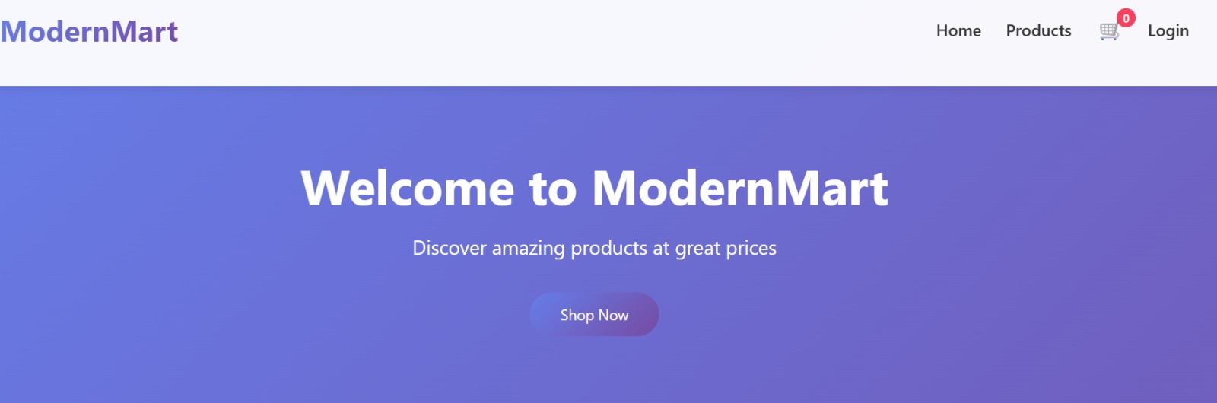
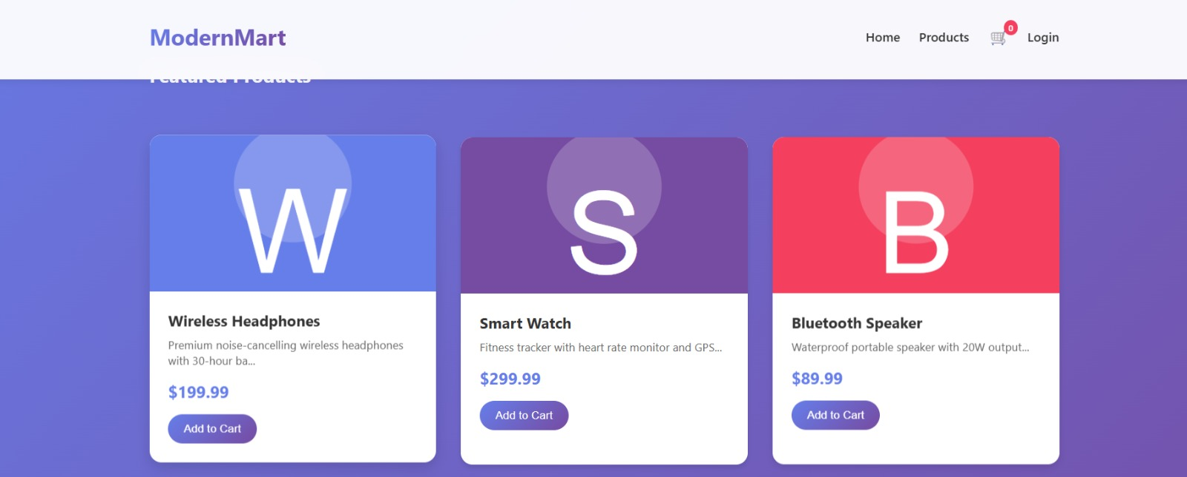
IMPLEMENTATION SCREENSHOTS
v
1
2
Home Page – Launches the Website and displays the overview of the website features
3
4
5
6
7
8
9

Slide 11
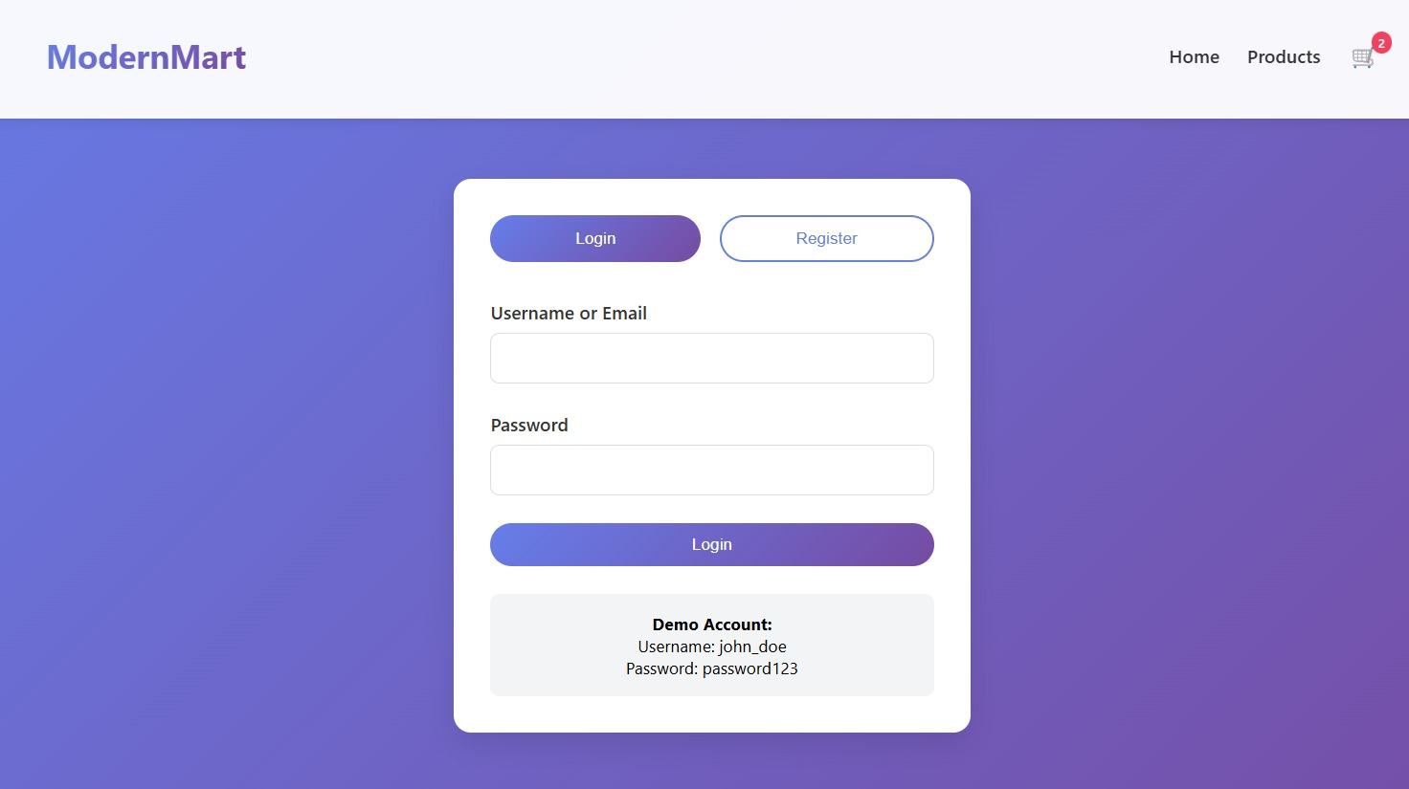
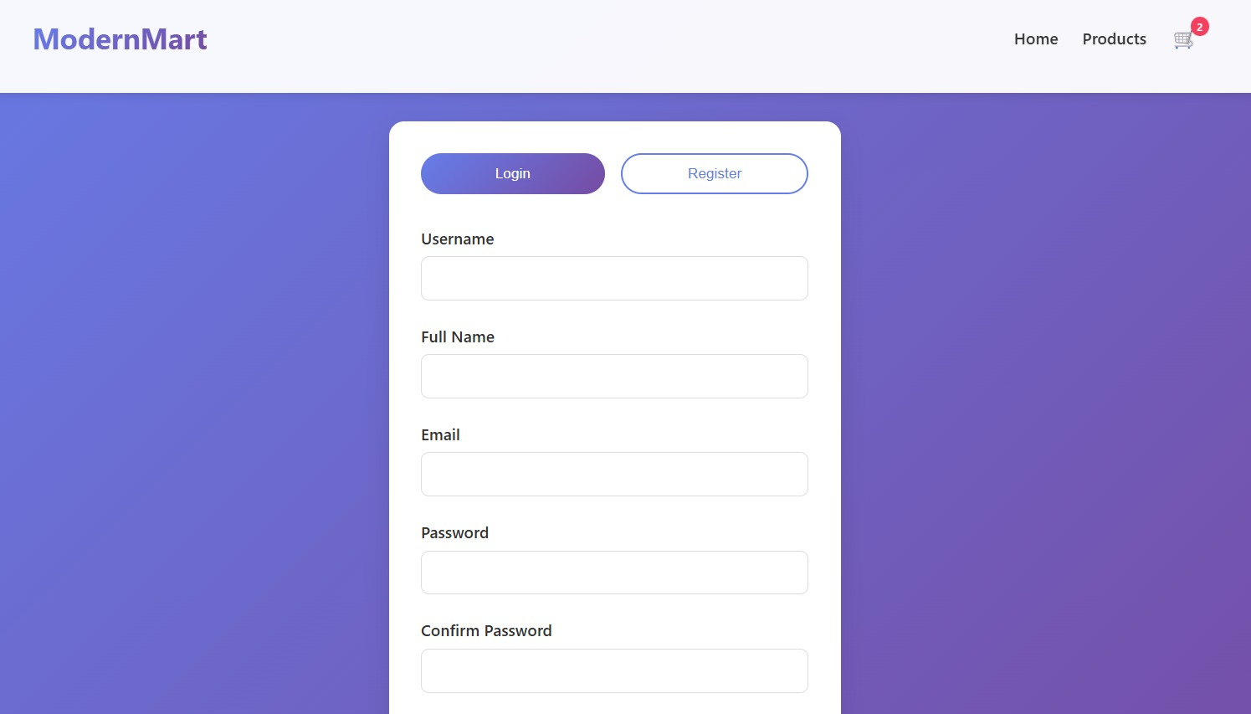
IMPLEMENTATION SCREENSHOTS
1
2
Register & Login Pages - Helps the user to create an account and login into it to keep a track of his orders,wishlist,,interests,etc
3
4
5
6
7
8(A)
9

Slide 12
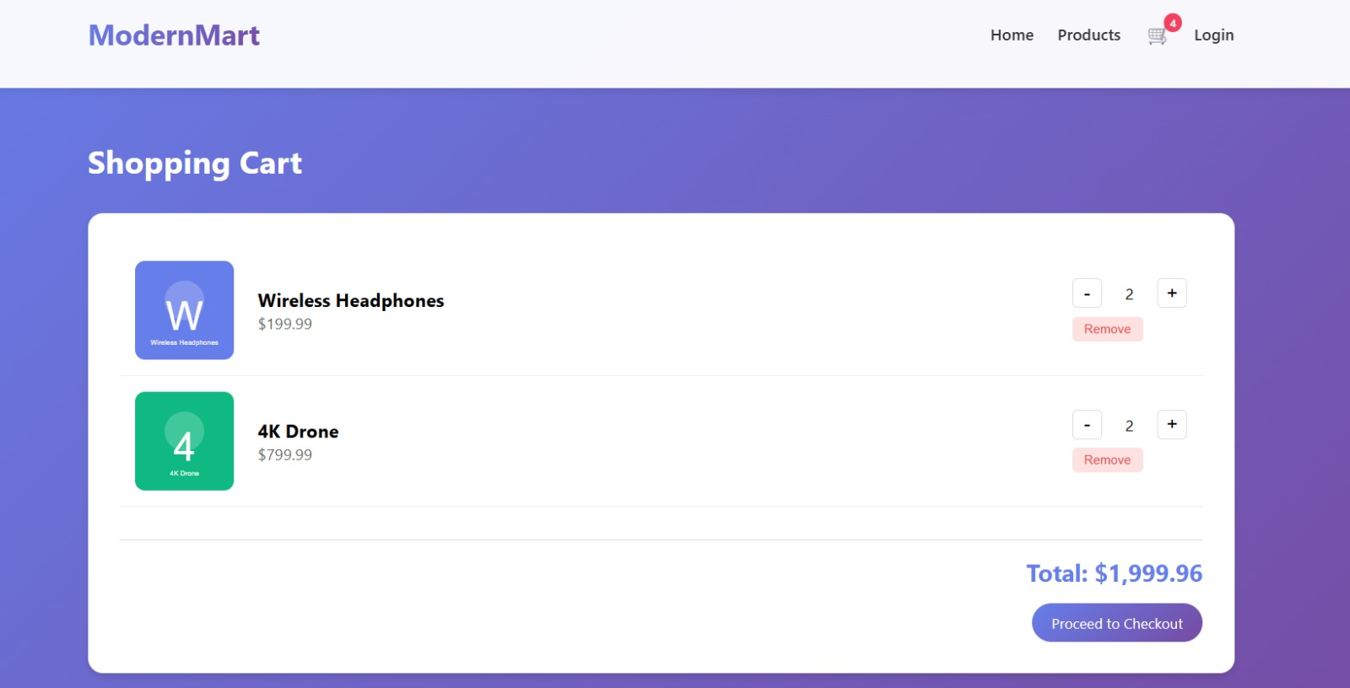
IMPLEMENTATION SCREENSHOTS
Products Page – Displays the products available in the website along with their price, stock available or not along with its image.
1
2
3
4
5
6
7
8(B)
9
Cart Page – Enables the user to add the products into the cart , review them before placing order for it like change the quantity of the product, removing the product .

Slide 13
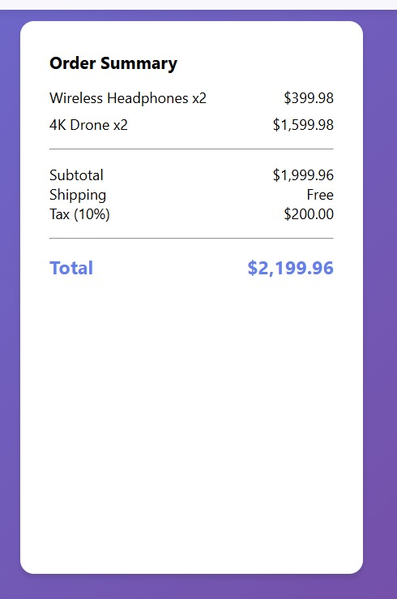
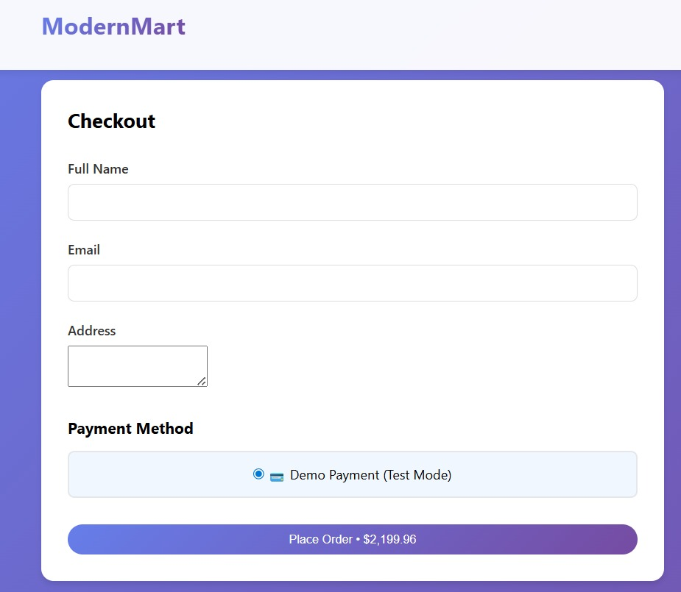
IMPLEMENTATION SCREENSHOTS
1
2
3
4
5
6
7
8(C)
Payment Page – It helps the user to place the order by completing the payment, here we show it as a demo feature .
9

Slide 14
ADVANTAGES & LIMITATIONS
1
Advantages
Secure Data Handling: Protects user information through server-side sanitization and hashed passwords to prevent SQL injection.
Real-time Validation: Enhances user experience with immediate feedback on form errors before data is even submitted to the server.
Efficient Logic: Streamlines the shopping process with a dedicated controller layer for seamless cart and wishlist management.
Responsive Design: Ensures the system architecture supports a fluid "User View" across both desktop and mobile devices.
Limitations
Payment Integration: Currently focuses on frontend/backend workflow and does not include a live third-party payment gateway.
Advanced Analytics: While it generates dynamic pages, it lacks deep AI-driven insights for personalized user recommendations.
Scale Constraints: Designed as a localized system architecture, which may require cloud-scaling for extremely high traffic volumes.
No Offline Mode: Requires a continuous connection to the PHP server and MySQL database to process any core transactions.
2
3
4
5
6
7
8
9

Slide 15
Thank you

